Slide 1
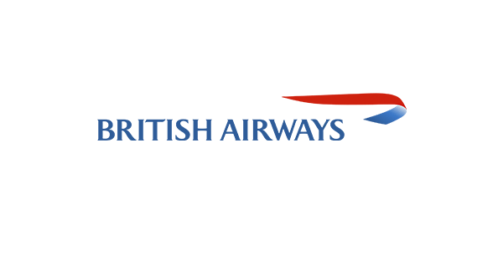
SKYTRAX RATING REVIEW
By Ruth Wangechi

Slide 2
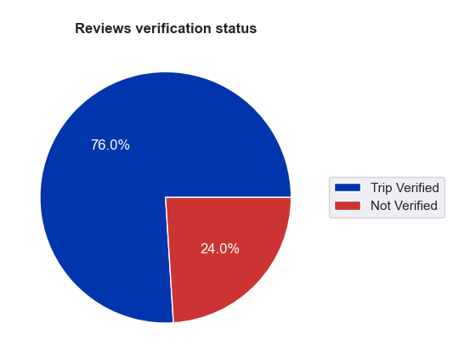
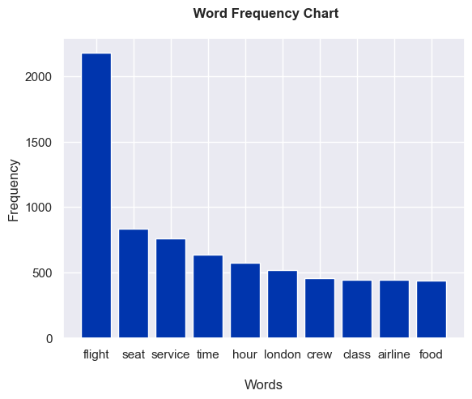
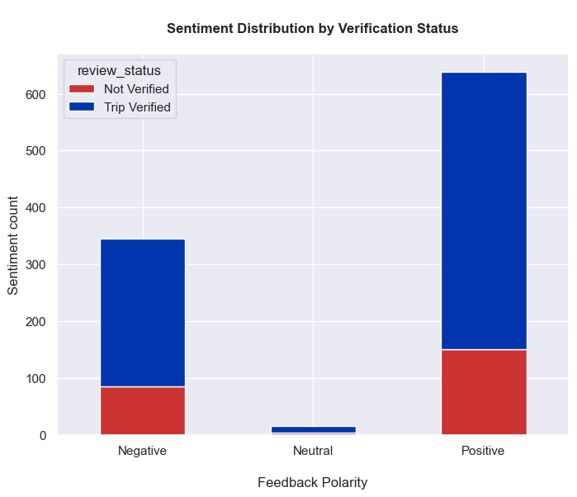
63.9%
Positive Reviews
34.5%
Negative Reviews
1.6%
Neutral
Summary
76% of our reviews are verified meaning three quarters of our data is from passengers who have supplied proof of travel with British Airways.
Majority of our reviews are polarised with majority leaning towards positive reviews.
The review content can be trusted since the top 10 keywords revolve around the flight, service delivery quality parameters, destinations, staff and our amenities.

